Slide 1
Association between digital biomarkers, loneliness and social isolation
A systematic review and meta-analysis
Journal: BMJ Mental Health
January 17, 2025
Email: n.marchant@ucl.ac.uk

Slide 2






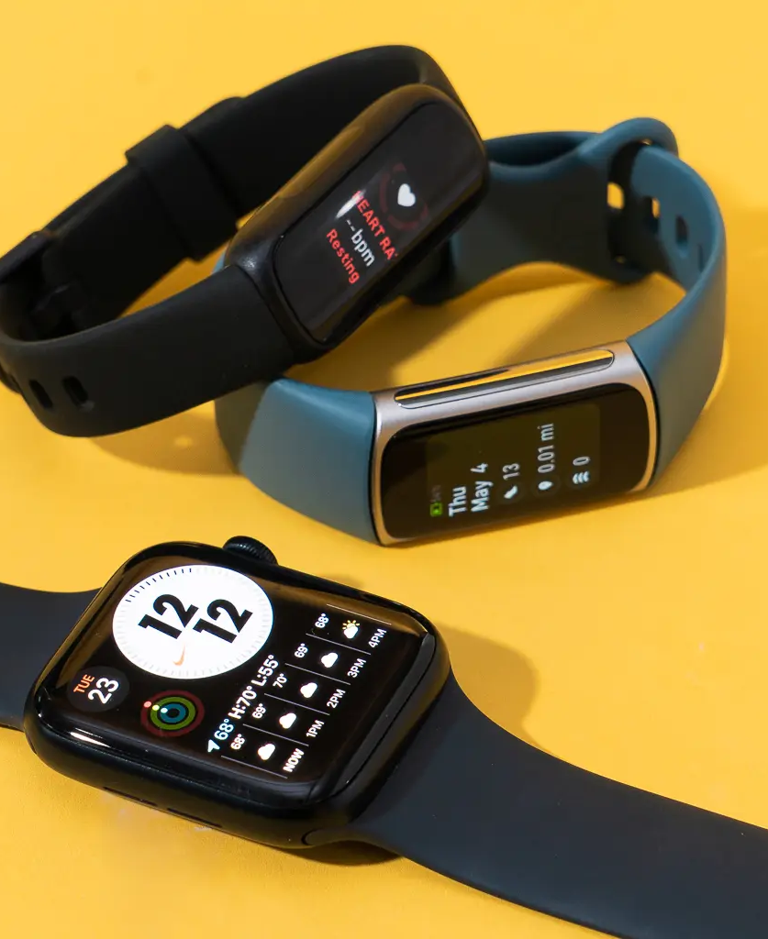
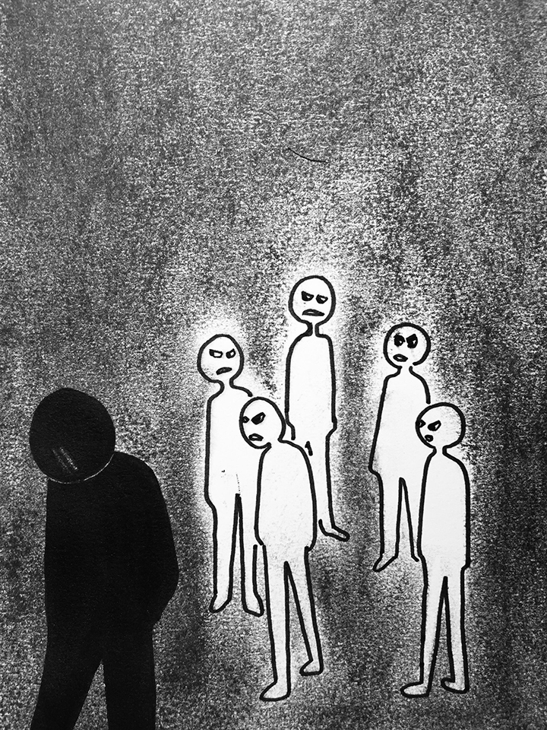






Abstract
Question?

Slide 3

Abstract:
Study selection and analysis
Question?

Slide 4

Abstract:
Findings
14 studies from 12 articles
Question?
Study selection and analysis

Slide 5
Abstract:
Findings
14 studies from 12 articles
8 studies used sleep metrics
4 studies used physical activity
2 studies applied machine learning approaches
Question?
Study selection and analysis

Slide 6
Abstract:
Findings
14 studies from 12 articles
12 studies assessing loneliness
2 assessing social isolation
Question?
Study selection and analysis

Slide 7
Abstract
Conclusions
Worse SE, more WASO, and lower total physical activity => loneliness and isolation
Digital biomarkers-based machine learning studies show potential in predicting loneliness.
Leveraging Digital biomarkers as proxy markers of loneliness and social isolation could facilitate early detection of these conditions
Question?
Study selection and analysis
Findings

Slide 8
Abstract
Key messages of the articles
What is already known on this topic?
What this study adds?
How this study might affect research, practice or policy?
Question?
Study selection and analysis
Findings
Conclusions
Worse SE, more WASO, and lower total physical activity => loneliness and isolation
Digital biomarkers-based machine learning studies show potential in predicting loneliness.
Leveraging Digital biomarkers as proxy markers of loneliness and social isolation could facilitate early detection of these conditions

Slide 9












Introduction
This review aims to explore whether digital biomarkers can serve as screening tools for dementia risk by monitoring these conditions.
To date, no systematic review has examined this association, highlighting the need for this research.

Slide 10
Introduction
Source pubmed

Slide 11
Method
Search strategy
Study selection
Data extraction and quality assessment
Synthesis and analysis

Slide 12
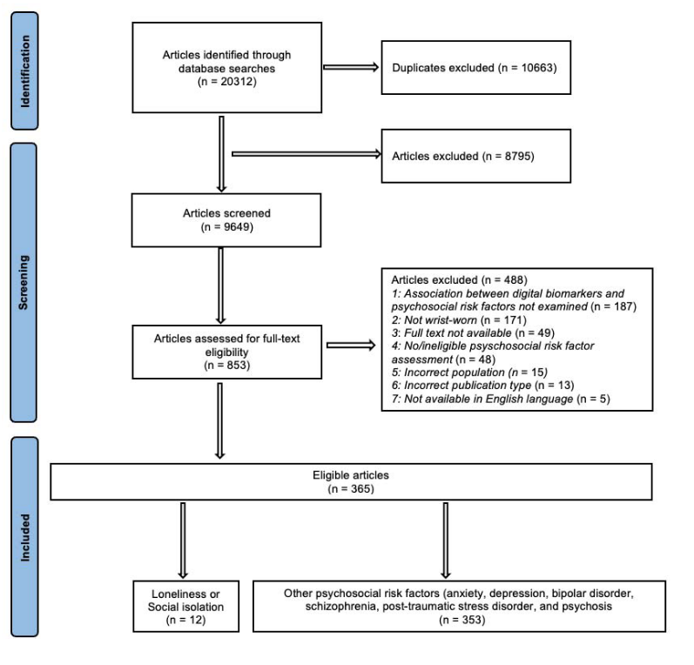
Method
This review adhered to the guidelines outlined in the Preferred Reporting Items for Systematic Reviews and Meta-Analyses (PRISMA) recommendation.
PRISMA flow diagram illustrating the systematic review process

Slide 13
Search Strategy
Five databases were systematically searched:
Medline
Embase
PsyschINFO
Web of Science
CINAHL
Google Scholar
The first 300 papers on Google Scholar were checked as per recommendations

Slide 14
Study Selection
Were cross-sectional or longitudinal in design.
Included adults aged ≥18 years.
Used research or consumer-grade wrist-worn devices.
Assessed loneliness or social isolation through self-reported standardized measures (e.g., questionnaires).
Were written in English.
Examined the association between digital biomarkers from wrist-worn devices and loneliness/social isolation.
Inclusion Criteria: Studies were eligible if they:
Exclusion Criteria: Studies were excluded if they:
Focused on individuals with neurodegenerative disorders or physical health conditions.

Slide 15
Synthesis and analysis
"Synthesis and Analysis" refers to the process of combining and evaluating information to draw meaningful conclusions.
Synthesis involves integrating findings from multiple sources to identify patterns, relationships, or overarching themes.
Analysis refers to critically examining the data, breaking it down, and interpreting its significance.
In research, this section typically summarizes results, compares findings across studies, and explores their implications.

Slide 16
Results
Study selection
Study and participants characteristics
Quality assessment
Studies using inferential statistical approaches: sleep
Studies using inferential statistical approaches: physical activity
Studies using machine learning approaches

Slide 17
Studies using inferential statistical approaches: sleep
Sleep onset latency (SOL)
Total sleep time (TST)
Sleep efficiency (SE)
Wake after sleep onset (WASO)

Slide 18
Studies using inferential statistical approaches: physical activity

Slide 19
Studies using machine learning approaches
First Study
Second Study
Used heart rate from wrist-worn wearables, smart rings, and smartphones.
Trained four models using data from:
Smart rings
Wrist-worn wearables
Smartphones
All three devices combined
The best accuracy (81.0%) came from the smartphone-based model, while the wrist-worn wearables model had 78.1% accuracy.
When analyzing the most important features, none of the top six came from wrist-worn devices.
Used steps and sleep data from wrist-worn devices along with smartphone data (call logs, location, screen status).
The best model (80.2% accuracy) included steps, sleep, call logs, location patterns, and screen status.
Another model (88.4% accuracy) predicted changes in loneliness over a school semester but relied only on smartphone data (Bluetooth, call logs, location) and did not use wrist-worn device data.
Doryab, A. et al. Identifying Behavioral Phenotypes of Loneliness and Social Isolation with Passive Sensing: Statistical Analysis, Data Mining and Machine Learning of Smartphone and Fitbit Data. JMIR mHealth and uHealth 7, e13209 (2019).
Jafarlou, S. et al. Objective monitoring of loneliness levels using smart devices: A multi-device approach for mental health applications. PLoS One 19, e0298949 (2024).

Slide 20
Discussion
Sleep
Physical activity
Studies using machine learning approaches

Slide 21
Limitations & Future Directions
Limited research on social isolation and physical activity prevents firm conclusions.
Most studies used research-grade devices, requiring further validation with consumer-grade wearables.
The cross-sectional nature of most studies limits the ability to track changes over time.
More machine learning research is needed, especially in older adults, to explore its potential in detecting loneliness and dementia risk.

Slide 22
Conclusion
Poor sleep efficiency and longer wake after sleep onset were linked to higher loneliness and social isolation.
Increased physical activity was associated with lower loneliness and social isolation, especially in middle-aged and older adults.
Machine learning showed promise in predicting loneliness but was mostly studied in young adults.
Given the high prevalence and dementia risk associated with loneliness in older adults, more research is needed to explore digital biomarkers for early detection.

